Slide 1

HR Analytics Project
HR Analytics Project
Employee Performance & Retention Analysis
Digital Egypt Pioneers Initiative (DEPI) – Data Analysis Track
Team Members :
Arwa Kassim (Team Leader)
Mohamed Abdelbary
Ali Mamdouh
Gehad Adel
Rawan Adel

Slide 2
Project Concept & Value
Problem Description:
Despite having a high average salary ($112.96K), the organization faces a critical retention challenge with an overall attrition rate of 16.12%. The primary issue is a lack of data-driven insight into which specific factors—such as overtime work (28% attrition rate), early tenure (0-3 years), or departmental risk (56.12% of attrition in Technology)—are driving employee turnover and burnout.
Proposed Solution:
The proposed solution is the Human Resources Data Analysis Project, delivered as an interactive Power BI Dashboard. This solution moves beyond descriptive statistics to conduct diagnostic analysis, exploring key workforce indicators (KPIs) like attrition rate, performance rating (Avg: 3.47), and job satisfaction levels. This provides HR leadership with a centralized, visual tool for strategic decision-making.
Unique Value Proposition:
Our project's unique value lies in its data integrity and predictive focus. The data was rigorously cleaned—removing 19 duplicates and imputing missing categorical values using Python (Pandas) mode—to ensure accuracy. The analysis pinpoints the non-obvious correlation that high salaries do not guarantee high performance or satisfaction, forcing a strategic shift toward non-financial drivers like work-life balance and targeted retention efforts for the high-risk Technology and early-tenure groups.

Slide 3
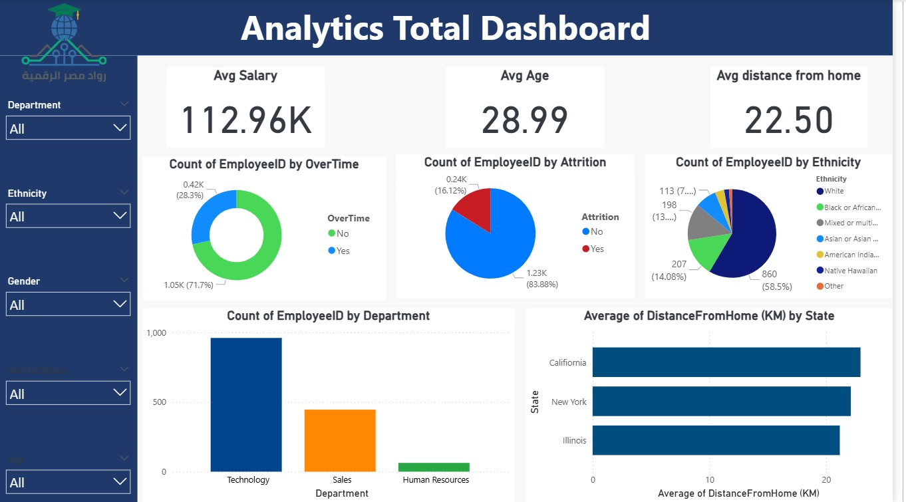
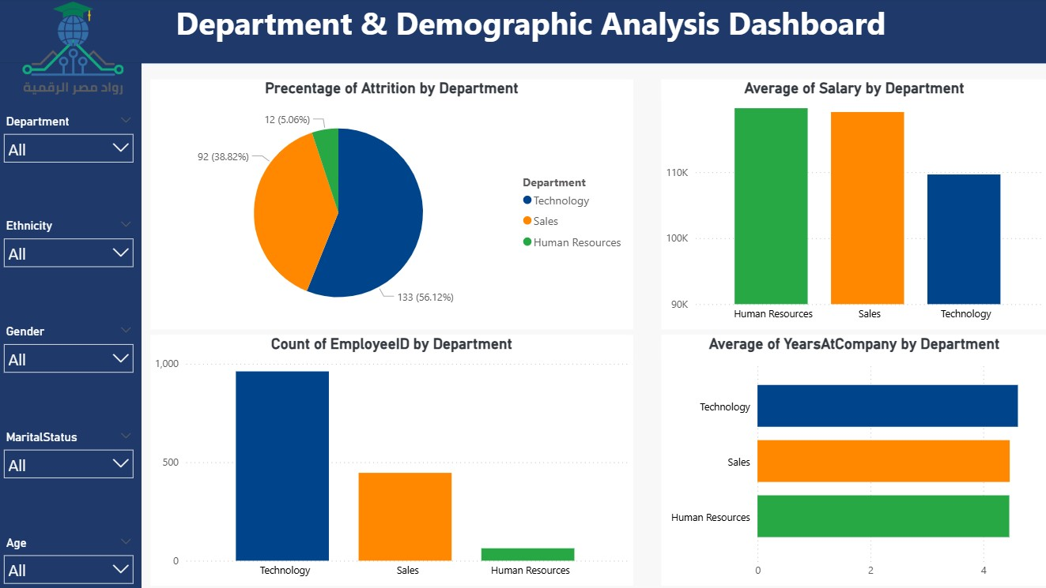
Visual Representation (Key Interfaces):
The solution is presented through a dynamic Power BI Dashboard interface. Key user interfaces include: 1. General Overview Dashboard (showing Avg Salary, Attrition Rate, and Overtime breakdown), 2. Department & Demographic Analysis (comparing salary and tenure across Technology, Sales, and HR), and 3. Performance Analysis (scatter plots of Salary vs. Manager Rating and tenure volatility).
User Journey / Usability Focus:
The dashboard is designed for maximum usability and data accessibility. The user journey is structured to enable efficient diagnostic analysis: 1. Global Filter: Use slicers (Age, Department, Ethnicity) on the left panel to instantly segment the data. 2. Diagnostic Drill-Down: Click on a high-risk department (e.g., Technology on the bar chart) to instantly filter all associated metrics (salary, attrition, tenure) across the entire interface. 3. Insight Generation: Managers can quickly confirm high-risk trends (e.g., the 28% attrition rate among overtime workers) and proceed to strategic action without delay.
Focus on Usability:
The interface prioritizes clear visual hierarchy, using color-coding (e.g., red for high attrition rates) and consistent chart types (bar charts for comparison, line charts for trends over time) to minimize cognitive load. This ensures that HR professionals, regardless of their technical background, can extract critical insights effectively.
Project Wireframe

Slide 4
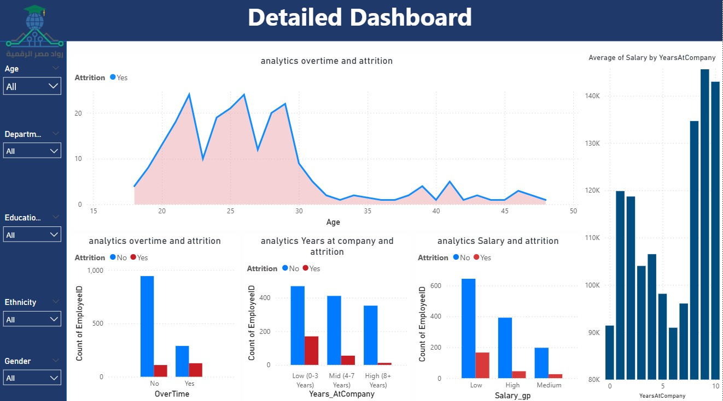
Primary User Personas:
1. HR Executives and Leadership: Focused on strategic decision-making, budget allocation, and high-level organizational planning.
2. Department Managers: Focused on managing team workload, conducting fair performance reviews, and addressing local burnout issues.
Key Features Addressing Needs:
1. High-Risk Group Identification: Provides clear visualization of primary retention risk factors (e.g., Early Tenure (0-3 years), Overtime, Low Salary Groups).
2. Departmental Comparative Analysis: Enables cross-department comparisons of average salary, average tenure, and attrition percentages (e.g., comparing Technology's 56.12% attrition risk vs. Sales' 38.82%).
3. Performance and Compensation Alignment Check: Visual correlation of Salary vs. Performance Rating, showing that high compensation does not always guarantee high output or satisfaction.
Feature-to-Solution Mapping:
The features directly support the objective of improving retention. For HR Executives: The platform enables the creation of organization-wide initiatives (e.g., implementing an enhanced Rewards & Recognition Framework) by proving, for instance, that non-high performers report higher satisfaction, indicating misaligned incentives. For Department Managers: They can use the Overtime Analysis feature to immediately re-evaluate workload distribution or offer compensatory flexibility to mitigate the identified 28% attrition rate among overtime workers.
End Users + Features

Slide 5
Database Architecture & Entities:
The dataset uses a simple, denormalized structure (relational principles applied within a single model) appropriate for the defined scope. The key entities focus on employee attributes: Employee Demographics (Age, Gender, Ethnicity), Job Data (Department, Years at Company, Job Role), Financial Data (Salary), and Behavioral Metrics (Overtime, Performance Rating, Attrition).
Data Shape and Features:
The initial data comprised multiple Excel files (SatisfiedLevel.xlsx and Employee (E.xlsx)) which were consolidated into a single analytical model representing approximately 1.47K employees. Target Variable: The dataset is unbalanced, with a lower volume of 'Yes' attrition cases (16.12%) compared to 'No' (83.88%). Key Features include categorical data (Education Level, Department) and numerical data (Salary, Years at Company, Distance From Home).
Data Cleaning and Flow:
Data Source: Raw, uncleaned dataset from Kaggle (abdelrahmangamal236/hr-datasets-not-cleaned). Cleaning Process: Performed using Python (Pandas) scripts: 1. Duplicate Removal: 19 duplicate records were identified and removed. 2. Missing Data Imputation: Missing values in key categorical columns ('Gender', 'Department', 'State') were imputed using the Mode (most frequent value) to minimize bias and preserve distribution.
Data Structure

Slide 6
Main Programming Language:
Python (Core language for data preparation and processing).
Frameworks and Libraries:
Pandas: Utilized extensively for the entire Data Cleaning and Wrangling phase, including file loading, merging, duplicate removal, and imputation techniques (mode imputation).
Data Visualization Tool:
Power BI: The primary tool for data modeling, creating relationships between tables, defining custom KPIs (using DAX), and developing the final interactive dashboards that visualize the findings.
Supporting Technologies:
Kaggle: Used for direct data ingestion from the Kaggle source repository.
Google Colab Notebook: Provided the accessible development environment for executing the Python data cleaning and preprocessing steps.
Programming Languages + Frameworks

Slide 7
Current State Overview:
The Power BI Dashboard is currently in a production-ready state, having been deployed for final review. It serves as the primary deliverable, featuring four interactive views (General, Department/Demographics, Performance, Education, details) and integrated slicers that allow HR users to dynamically cross-filter all 1.47K employee records based on Age, Department, Ethnicity, and Gender.
Key Testing Phases:
1. Data Integrity Testing (Python/Pandas): Verification that the 19 duplicate entries were successfully removed and that Mode Imputation for missing categorical data (Gender, Department, State) was executed correctly, as detailed in the Data Wrangling Report.
2. Model Validation: Confirmed data relationships within the Power BI model are accurate for KPI calculation. This included testing the accuracy of the overall 16.12% Attrition Rate and the departmental attrition risk percentages (e.g., Technology at 56.12%).
3. User Acceptance Testing (UAT): Performed by project peers to ensure the dashboard’s usability, responsiveness, and intuitive navigation, confirming that the tool effectively supports the planned decision-making process.
Quality Assurance:
Quality Assurance confirmed the reliability of the core analytical findings, such as the clear demonstration that overtime workers experience a 28% attrition rate compared to 10% for non-overtime workers. No critical errors were identified, validating the data cleaning and transformation steps performed in Python.
Live Application + Testing

Slide 8
Reports and Documentation:
1. Data Wrangling Report: Technical documentation outlining the data collection, assessment (duplicates, missing values), cleaning, and imputation procedures executed in Python.
2. Business Insights Report: The strategic findings document, providing actionable recommendations (e.g., reducing overtime, strengthening early-tenure retention) based on the KPI analysis.
Timeline for Deliverables:
Other Final Products:
1. Interactive Power BI Dashboard: The primary functional deliverable, visualizing all performance, attrition, and demographic KPIs.
2. Source Code Repository: The Python script/notebook used for data cleaning and transformation (ETL process).
Deliverables
Project Kickoff & Data Understanding
Nov 08
Data Cleaning Report & Modeling Complete
Nov 15
Dashboard Development &Beta Testing
OCT 25
Nov 29
Final Presentation & Documentation Delivery

Slide 9
Project Team + Roles
Key Responsibilities:
• Rawan Adel & Mohamed Abdelbary (Data Preprocessing): Responsible for Python-based data cleaning, duplicate removal, and missing value imputation (mode) to prepare the initial dataset.
• Ali Mamdouh & Gehad Adel (Visualization & Modeling): Responsible for data modeling in Power BI, creating data relationships, defining KPIs, and designing the interactive dashboard interface.
• Arwa Kassim (Reporting & Documentation): Responsible for generating the Data Wrangling Report and the final Business Insights Report.
• Gehad Adel (Presentation): Responsible for preparing the PowerPoint slides and delivering the final presentation.
Collaboration Methods:
The team operated through defined phases and clear deadlines as documented in the Project Plan. Collaboration was focused on sequential hand-offs: Data Cleaning (Python) was completed before Data Modeling (Power BI) could begin, ensuring high data quality was maintained throughout the process.

Slide 10

Thank you!
We are now open for questions.
arwamac2016@gmail.com
Human Resources Data Analysis Project

